Slide 1
CSS Essentials

Slide 2
Contents
CSS terminology
Defining simple selectors
Defining relational selectors
Defining attribute selectors
Chaining and grouping selectors
Pseudo-classes and pseudo-elements
Demos folder:
Demos\A-CssEssentials

Slide 3
1. CSS Terminology
Style rules
Declarations
Selectors

Slide 4
Style Rules
A CSS style sheet is a collection of style rules
For example, this style sheet comprises two style rules:
div {
color: red;
}
p {
color: blue;
}

Slide 5
Declarations
Each style rule has a declaration block (i.e. the {} curly brackets)
The declaration block contains a series of declarations
Each declaration is terminated by a semi-colon
Each declaration defines:
A property:value pair
Properties are things like color, font-family, and width
Values are things like red, Tahoma, and 30%
div {
color: red;
font-family: Tahoma, Arial, sans-serif;
width: 30%;
}

Slide 6
Selectors
Each style rule specifies a selector
The selector defines which parts of the HTML document will be affected by the declarations
There are several types of selector:
Element selectors
Class selectors
ID selectors

Slide 7
2. Defining Simple Selectors
Selecting all elements
Element selectors
Class selectors
Id selectors
Combining selectors

Slide 8
Selecting All Elements
You can define a rule that selects all elements
* {
color: red;
}
Applies to all elements

Slide 9
Element Selectors
Element selectors are the simplest kind of selector
Also known as tag selectors
Select all elements in the document that have a particular tag name
The example at the start of this chapter used element selectors
See ElementSelectors.html
div {
color: red;
}
p {
color: blue;
}
Applies to all <div> elements
Applies to all <p> elements

Slide 10
Class Selectors
Class selectors apply to all elements that have a specified CSS class
Useful for applying the same style to different kinds of element
Example
See ClassSelectors.html
.optional {
background-color: #eeeeff;
}
.required {
background-color: #ffe0e0;
}
Applies to all elements whose class is "optional"
Applies to all elements whose class is "required"

Slide 11
ID Selectors
ID selectors apply to an element that has a specified id attribute
Useful for targeting a specific <div>, for example
Example
See IdSelectors.html
#mainContent {
color: blue;
background-color: #eeeeff;
}
#additionalContent {
color: red;
background-color: #ffeeee;
}
Applies to the element whose id is "mainContent"
Applies to the element whose id is "additionalContent"

Slide 12
Combining Selectors
You can combine element/class/id selectors
Use this syntax:
Example
See CombiningSelectors.html
anElementName#anId.aClassName {
declarations…
}
.standout {
color: orange;
font-size: 18pt;
font-weight: bold
}
h1.standout {
font-size: 36pt;
}
Applies to general elements whose class is "standout"
Applies to <h1> elements whose class is "standout"

Slide 13
3. Defining Positional Selectors
HTML document structure
Descendent selectors
Child selectors
Adjacent sibling selectors

Slide 14
HTML Document Structure
Consider this simple HTML document
The browser parses this HTML and creates a "DOM" tree
You can define CSS rules that target descendants, child elements, and adjacent siblings
<html>
<head>
<title>This is my simple page</title>
<meta name="author" content="John Smith"/>
<meta name="description" content="Simple example"/>
</head>
<body>
<p id="intro">This is the intro to my page</p>
<p id="main">This is the <b>main</b> content in my document</p>
</body>
</html>
html
head
body
title
meta
meta
p
p
b

Slide 15
Descendant Selectors
You can define a style rule that targets elements that are a descendant of an element
Also known as contextual selectors
Use this syntax:
Example
See DescendantSelectors.html
Discuss the rules, and describe the outcome
outerElement descendantElement {
declarations…
}

Slide 16
Child Selectors
You can define a style rule that targets elements that are a direct child of an element
Use this syntax:
Example
See ChildSelectors.html
Discuss the rules again, and describe the outcome
parentElement > childElement {
declarations…
}

Slide 17
Adjacent Sibling Selectors
You can define a style rule that targets elements that are siblings of an element (i.e. same parent)
Use this syntax:
Example
See AdjacentSiblingsSelectors.html
Discuss the rules again, and describe the outcome
firstElement + adjacentSiblingElement {
declarations…
}

Slide 18
4. Defining Attribute Selectors
Recap of attributes
Overview of attribute selectors
Testing for attribute presence
Testing for an attribute value

Slide 19
Recap of Attributes
Some HTML elements can have attributes
For example:
<table>
<tr>
<td colspan="3">
…
<input type="text" size="20" … />
<input type="submit" value="submit" … />

Slide 20
Overview of Attribute Selectors
You can define style rules that target elements based on attributes on the elements
Use [] to denote the attribute of interest
You can select elements based on:
The presence of an attribute
The value of an attribute

Slide 21
Testing for Attribute Presence
You can define a style rule that targets elements that have a particular attribute (regardless of its value)
Use this syntax:
Example
See AttributePresenceSelectors.html
anElementName[anAttributeName] {
declarations…
}
a[name] {
color: blue;
}
a[href] {
color: orange;
}
Applies to bookmarks
Applies to hyperlinks

Slide 22
Testing for an Attribute Value
You can define a style rule that targets elements that have a particular attribute value
Use = to test the equality
Use ^= to test for "starts with of equals" (buggy)
Example
See AttributeValueSelectors.html
img[src="euroImages/Wales.png"] {
width: 200px;
}
img[src^="nonEuroImages/"] {
width: 100px;
}
Applies to specific image
Applies to all images in a subfolder

Slide 23
5. Chaining and Grouping Selectors
Chaining selectors
Grouping selectors

Slide 24
Chaining Selectors
You can chain selectors together
Example
What does this rule mean?
#mainContent div.narrative h4 + ul > li a[href^="http://acme.com"] {
font-size: 20pt;
}

Slide 25
Grouping Selectors
You can group selectors together
Use a comma separator between selectors
Example
The following are equivalent!
h1 { color: orange; background-color: #ffeeee; }
h2 { color: orange; background-color: #ffeeee; }
h3 { color: orange; background-color: #ffeeee; }
h4 { color: orange; background-color: #ffeeee; }
h5 { color: orange; background-color: #ffeeee; }
h6 { color: orange; background-color: #ffeeee; }
h1, h2, h3, h4, h5, h6 { color: orange; background-color: #ffeeee; }

Slide 26
6. Pseudo-Classes and Pseudo-Elements
Overview of pseudo-classes
Using pseudo-classes with hyperlinks
:focus pseudo-class
Overview of pseudo-elements
:first-child pseudo-element
:first-line pseudo-element
:first-letter pseudo-element
:before and :after pseudo-elements

Slide 27
Overview of Pseudo-Classes
CSS supports the concept of pseudo-classes
i.e. additional qualifiers that you can place on a selector
Allows you to fine-tune when the rule applies
General syntax for pseudo-classes:
aSelector:pseudoClass {
declarations…
}

Slide 28
Using Pseudo-Classes with Hyperlinks
CSS supports several pseudo-classes for hyperlinks
Note:
:hover must come after :link and :visited
:active must come after :hover
Example
See LinkPseudoClasses.html
Pseudo-class
Description
:link
Selects all unvisited links
:visited
Selects all visited links
:hover
Selects links on mouse-over
:active
Selects the active link

Slide 29
:focus Pseudo-Class
The :focus pseudo-class selects an element that has input focus
Example
See FocusPseudoClass.html
aSelector:focus {
declarations…
}

Slide 30
Overview of Pseudo-Elements
CSS supports the concept of pseudo-elements
i.e. additional qualifiers that you can place on a selector
Allows you to fine-tune when the rule applies
General syntax for pseudo-elements:
aSelector:pseudoElement {
declarations…
}

Slide 31
The :first-child Pseudo-Element
The :first-child pseudo-element selects an element that is the first child of another element
Example
See FirstChildPseudoElement.html
aSelector:first-child {
declarations…
}

Slide 32
The :first-line Pseudo-Element
The :first-line pseudo-element selects the first line within an element
Example
See FirstLinePseudoElement.html
aSelector:first-line {
declarations…
}

Slide 33
The :first-letter Pseudo-Element
The :first-letter pseudo-element selects the first letter within an element
Example
See FirstLetterPseudoElement.html
aSelector:first-letter {
declarations…
}

Slide 34
:before and :after Pseudo-Elements (1)
The :before and :after pseudo-elements can be used to insert some content before/after the content of an element
aSelector:before {
content: someContent
}
aSelector:after {
content: someContent
}

Slide 35
:before and :after Pseudo-Elements (2)
You can generate the following kind of content for the :before and :after pseudo-elements:
A string
A URL
A counter
Note:
You can reset and increment a counter as follows:
To display a counter:
aSelector {
counter-reset: aCounter optValue;
}
aSelector {
counter-increment: aCounter optAmt;
}
For details of list styles, see: www.w3.org/TR/CSS2/generate.html #propdef-list-style-type
aSelector {
content: counter(aCounter, aListStyle);
}

Slide 36
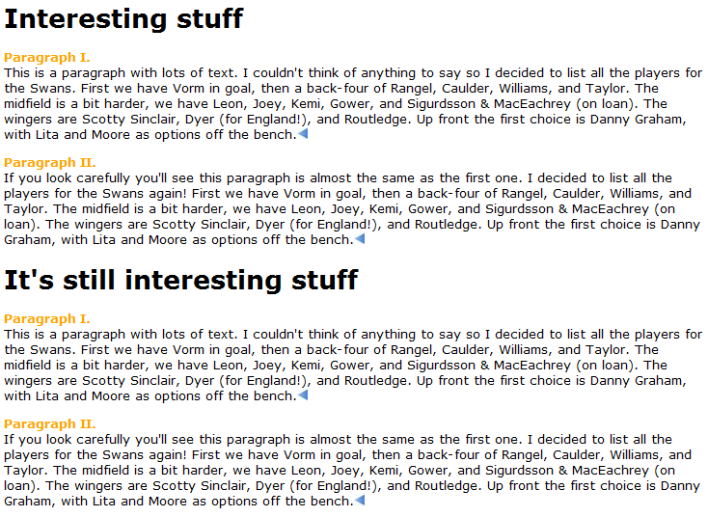
:before and :after Pseudo-Elements (3)
Example
See BeforeAndAfterPseudoElements.html
Illustrates various content types and techniques

Slide 37
Any Questions?

